Slide 1
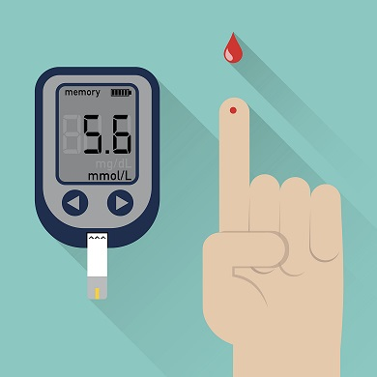
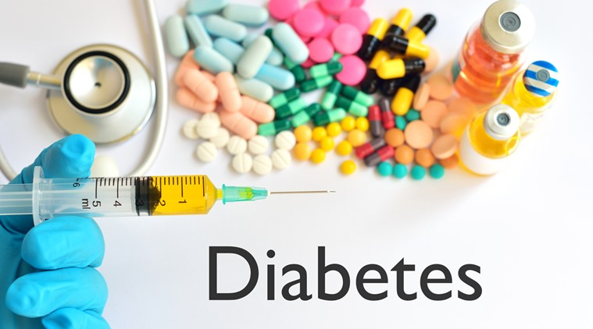
DIABETES PREDICTION
(USING CLASSIFICATION)

Slide 2
PROBLEM STATEMENT
To predict whether a person has diabetes or not using classification.

Slide 3
APPROACH
Data Exploration
Data Visualisation
Algorithm Used
Train And Test Data
Cross Validation

Slide 4
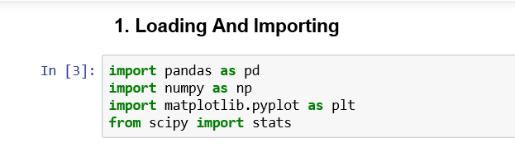
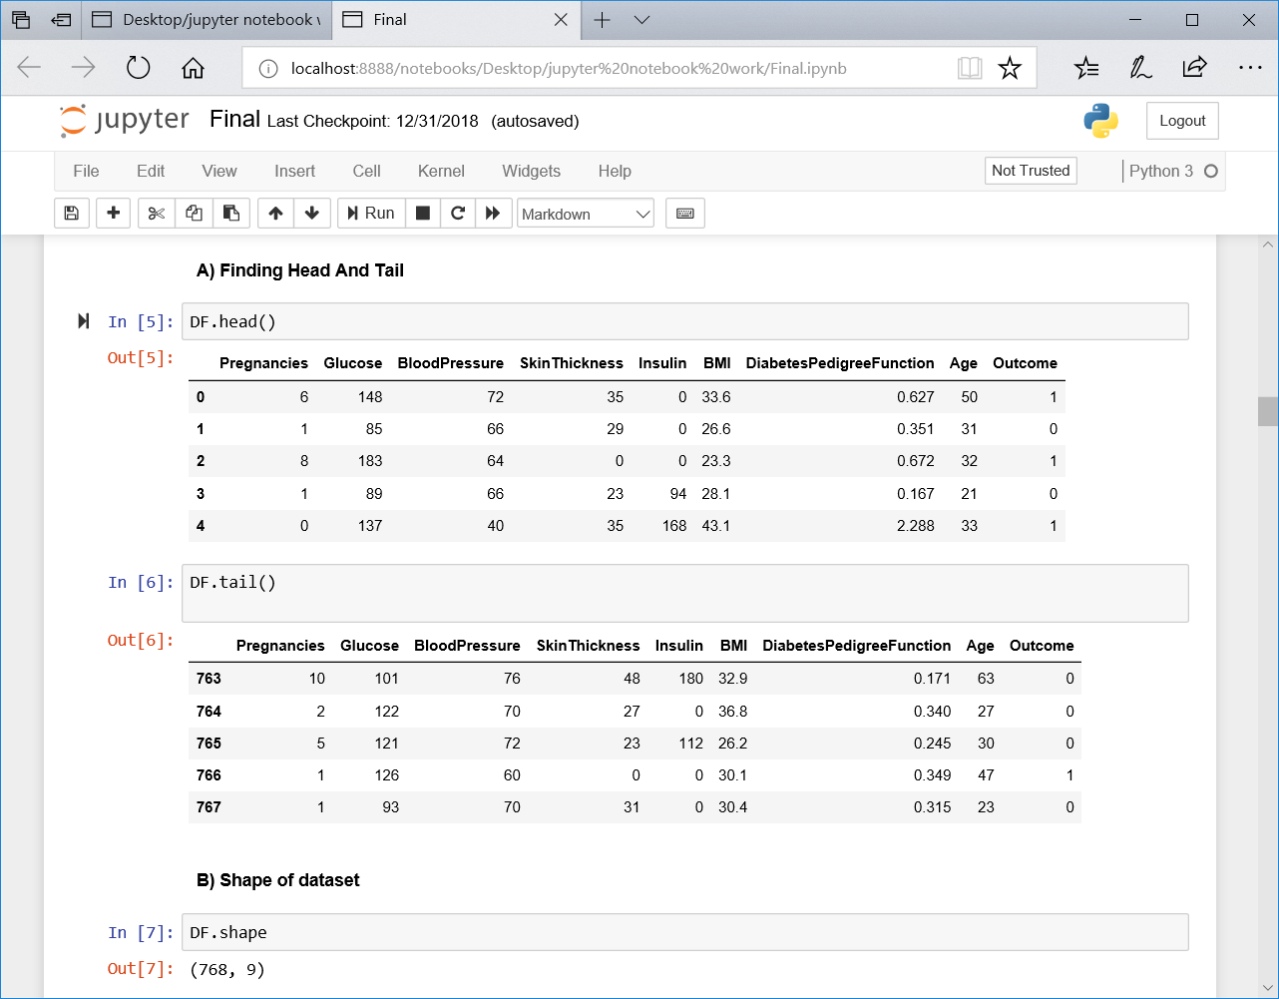
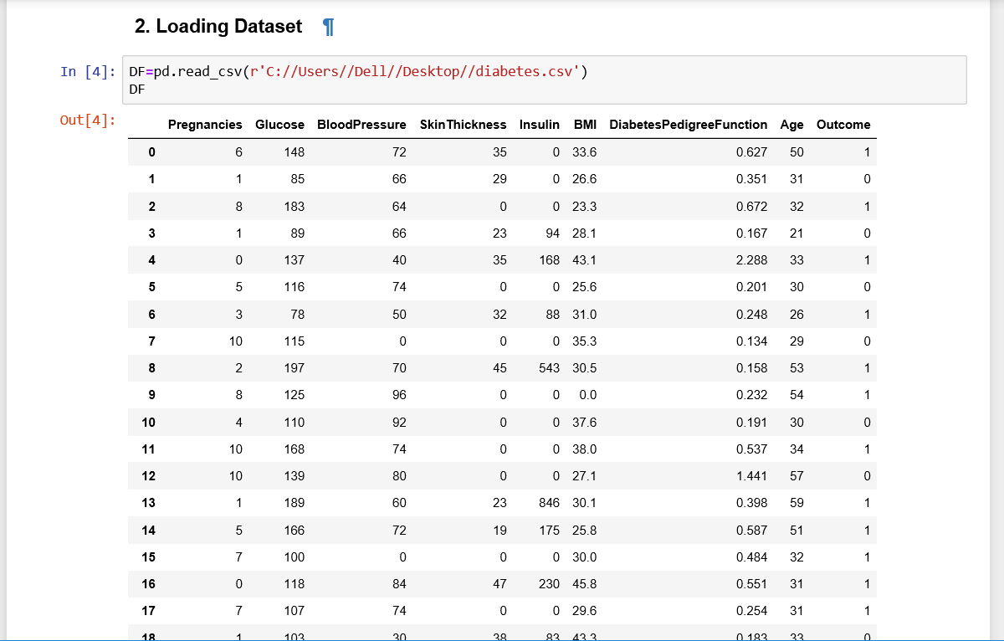
DATA EXPLORATION
Head means showing first five rows of a dataset.
Tail means showing last five rows of dataset.

Slide 5
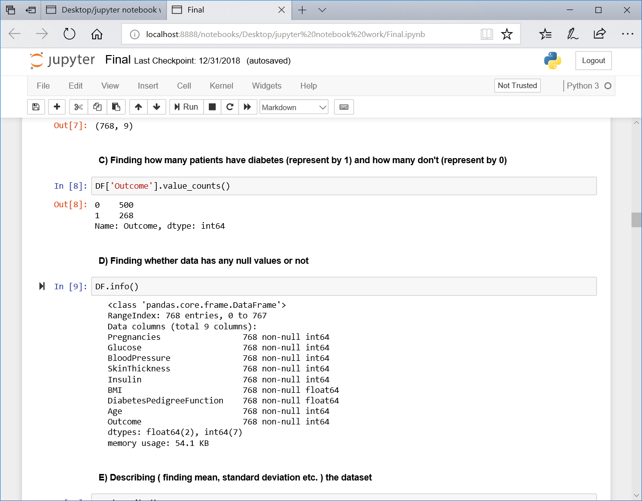
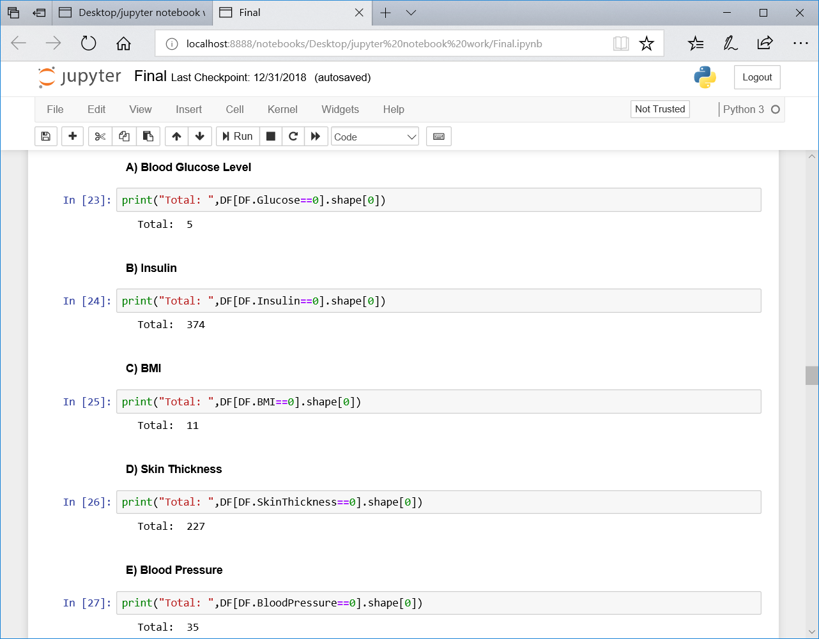
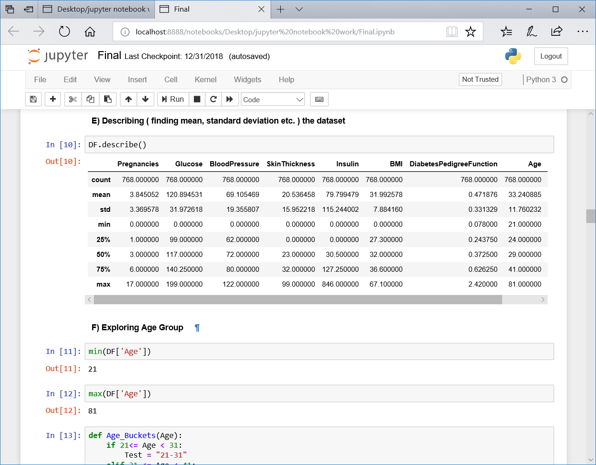
INVALID CASES

Slide 6
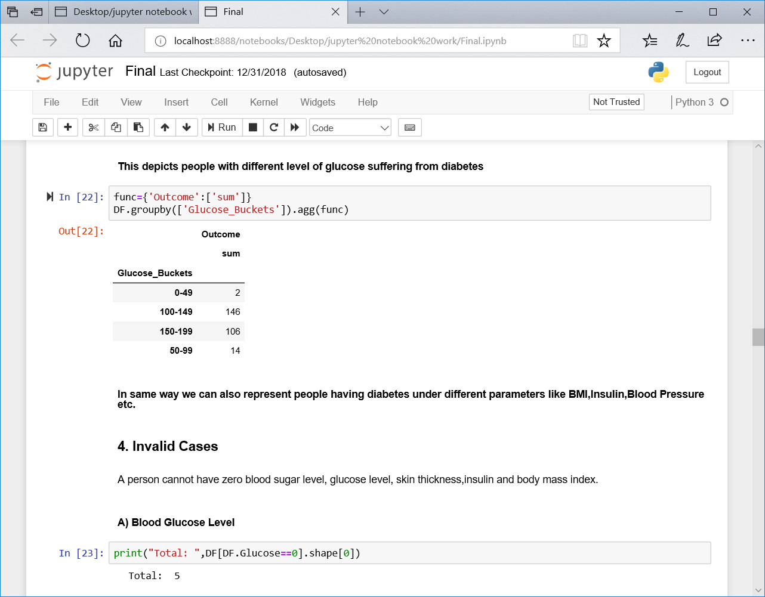
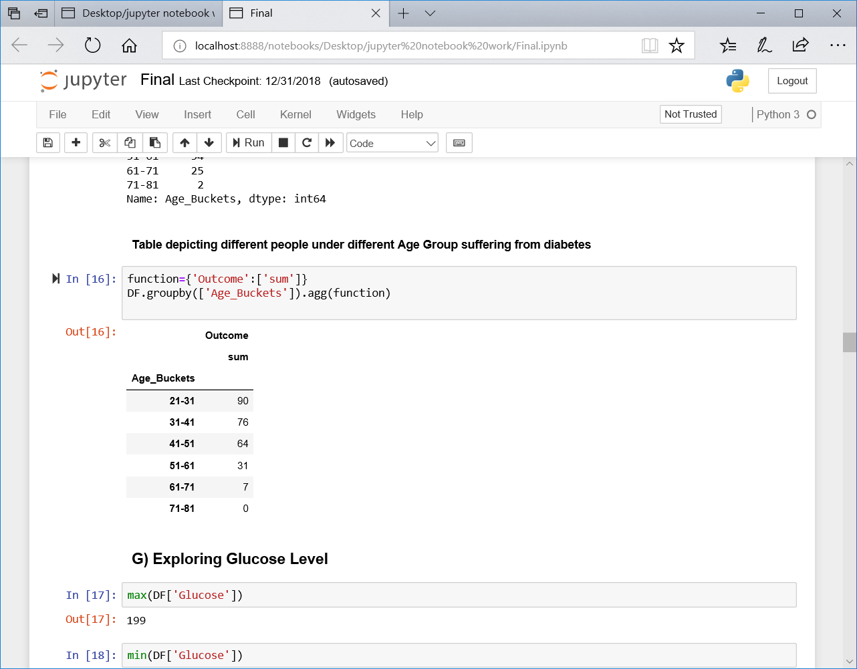
AGE BUCKET
GLUCOSE BUCKET

Slide 7
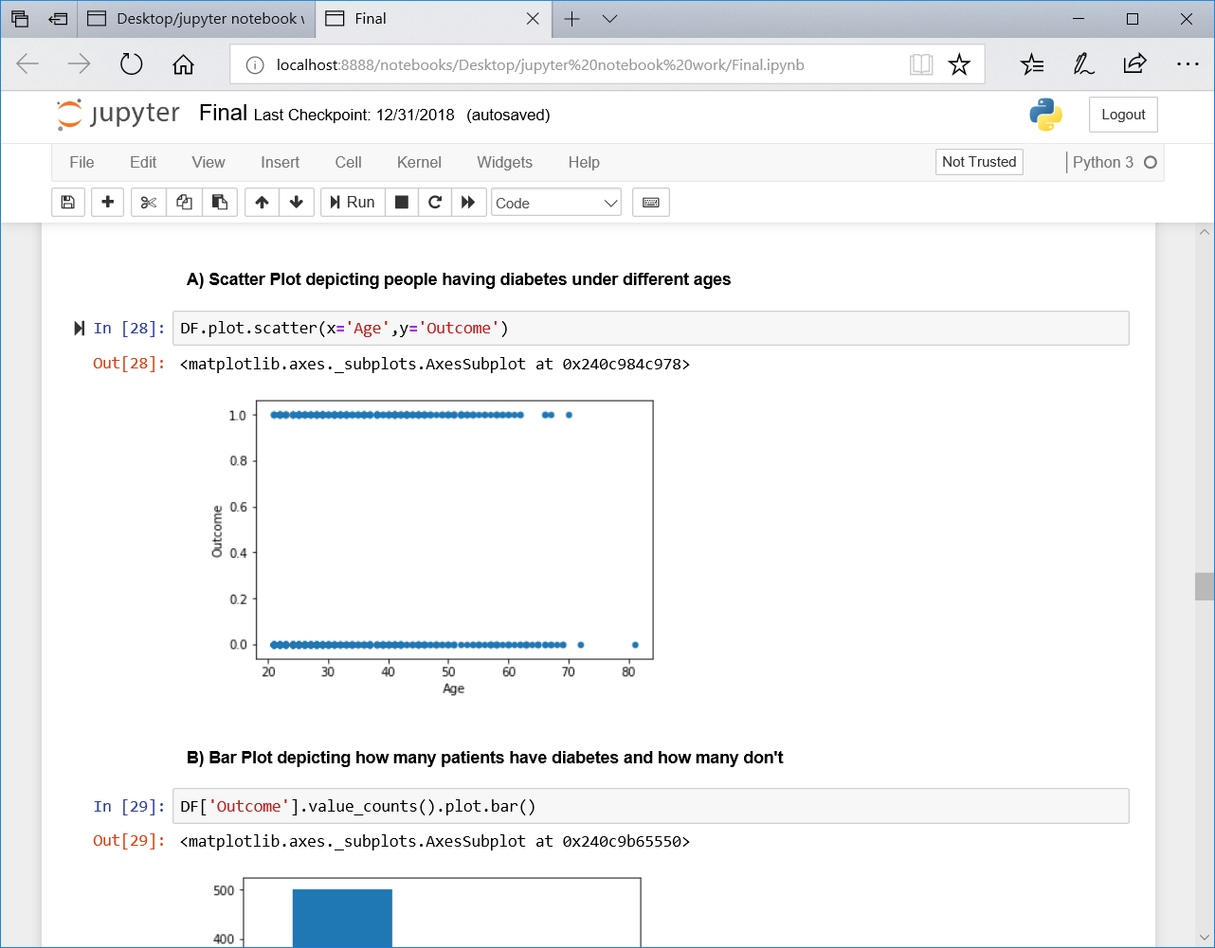
DATA VISUALISATION
Scatter plot is a 2-D graph
That depicts correlation between 2 variables (i.e. Age and Outcome
In this case ).
Position of point depends on 1 to 2-D value, where each value is a position on either horizontal or vertical dimension.

Slide 8
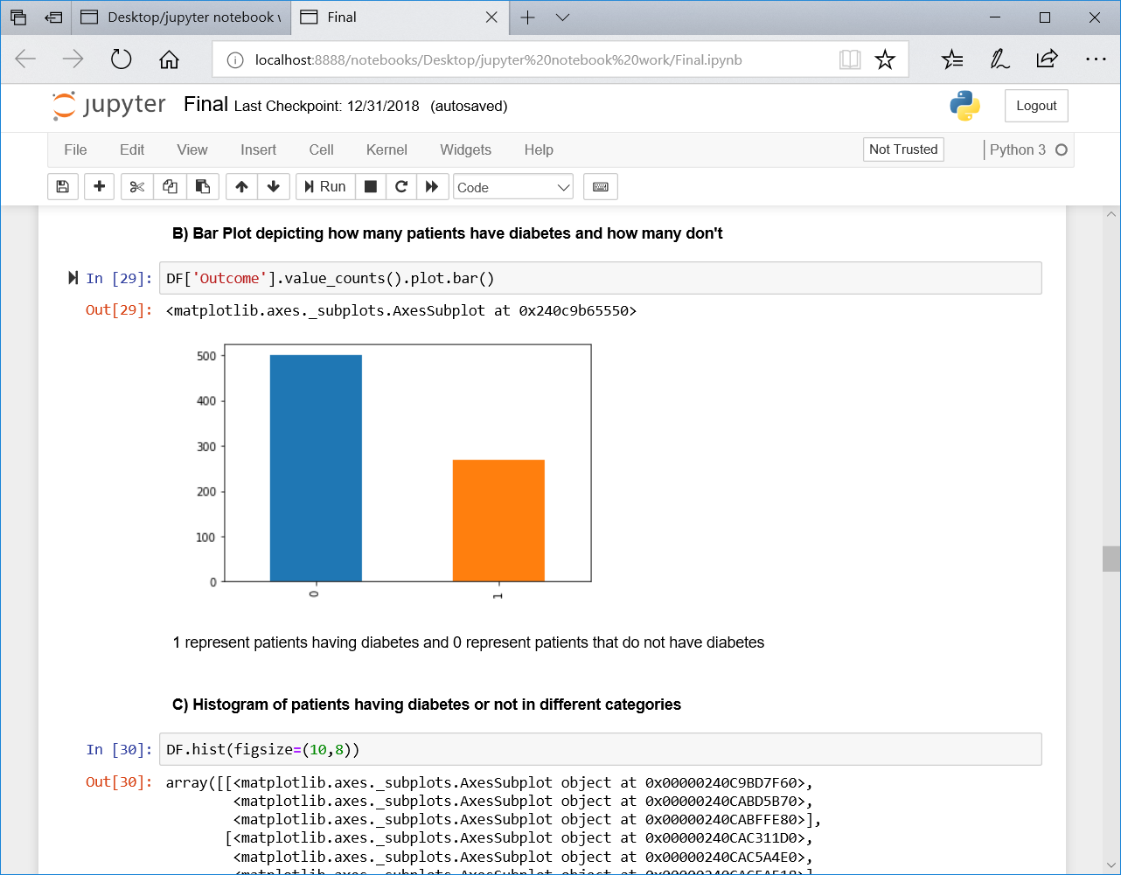
Bar graph depicts how many people have diabetes and how many do not have diabetes.
On basis of outcome number of people who do not have diabetes are 500 and people who have are 268.

Slide 9
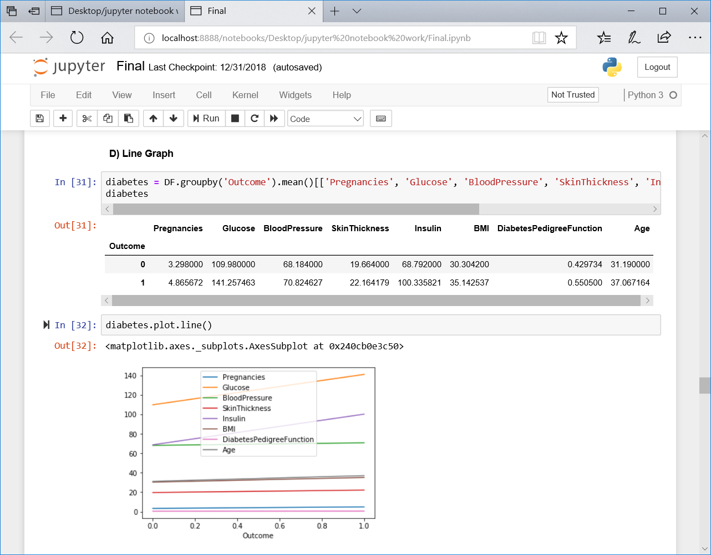
A Line Graph displays information as a series of data points called marker connected by straight line segments.
Here we have taken mean of different parameters( like BMI, glucose, blood pressure etc. ) and groupby them on basis of outcome i.e. people having diabetes and people who do not have diabetes on basis of different parameters and then we have plot it as line graph.

Slide 10
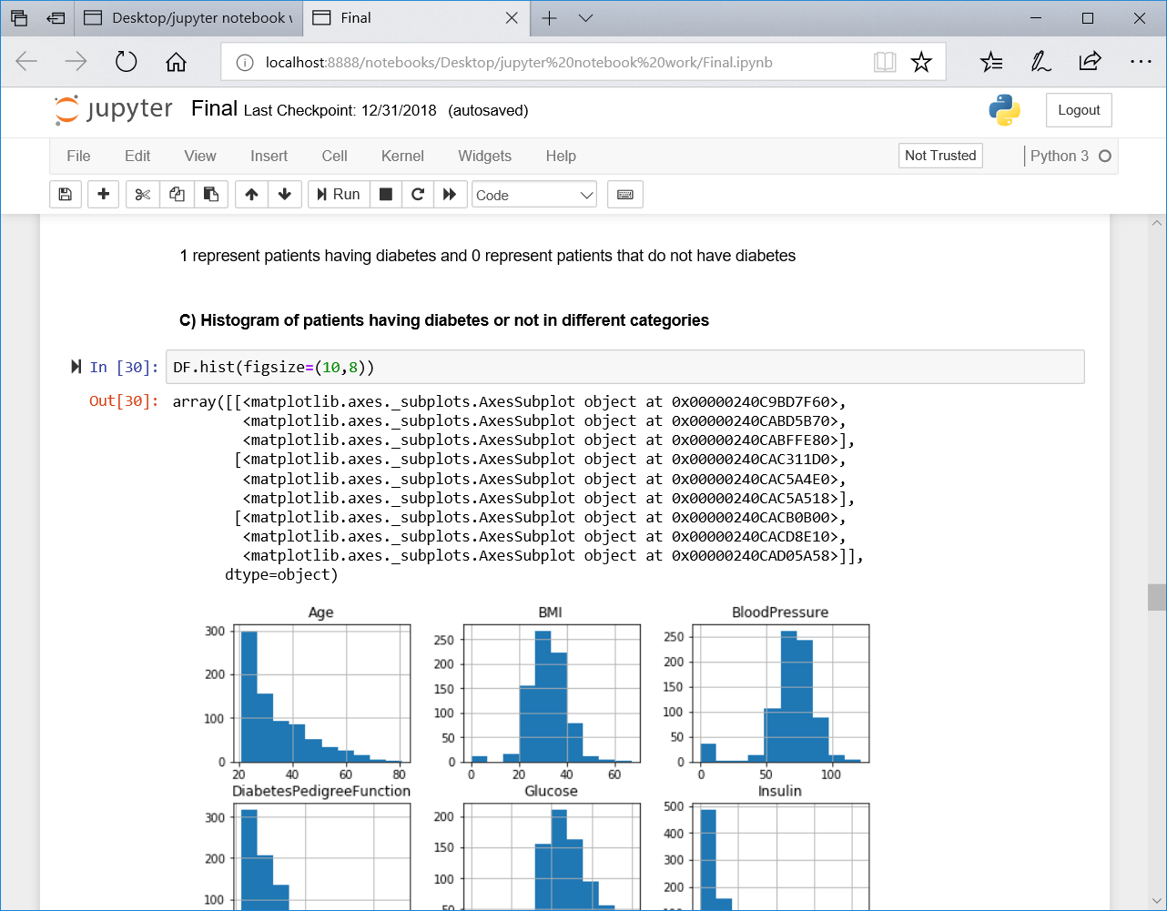
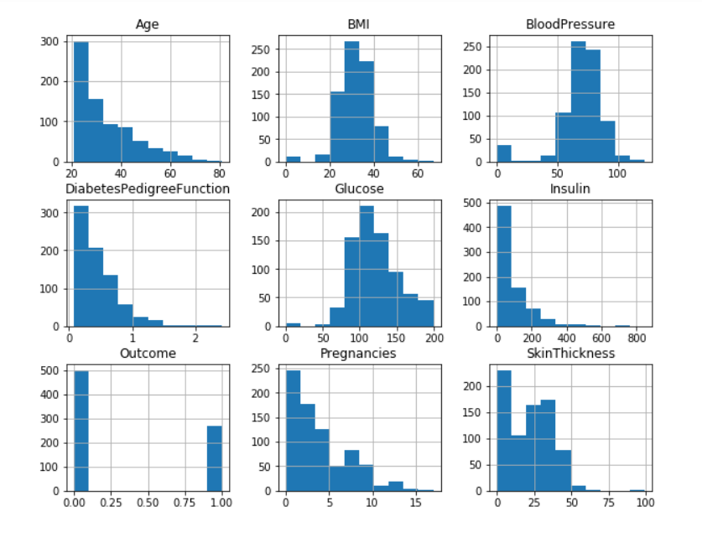
The histogram represents:
Attributes BMI, Blood Pressure, Glucose are found to be normally distributed.
Age, Diabetes Pedigree Function, Insulin, Pregnancies found to be exponentially distributed.

Slide 11
ALGORITHM USED
Machine learning algorithm used in this project is KNN (K-nearest-neighbors algorithm).
K-Nearest Neighbors (KNN) is one of the simplest algorithms used in Machine Learning for a classification problem.
KNN is a non-parametric learning algorithm, which means that it doesn't assume anything about the underlying data. This is an extremely useful feature since most of the real world data doesn't really follow any theoretical assumption.
It does not learn any model. It make predictions just in time by calculating similarity between input sample and each training instance. All training data is needed during testing phase.
We just need to vary the test and training size along with the K value to see how your results differ and how can you improve the accuracy of your algorithm.

Slide 12
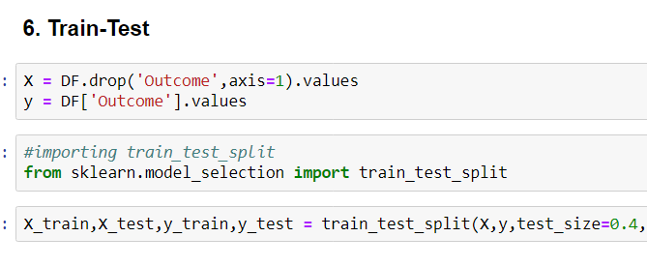
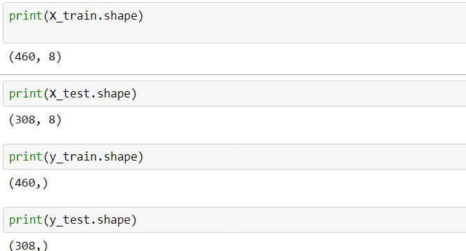
TRAIN AND TEST DATA
In the train_test_split() function, we passed the variable X and y that we obtained previously, along with test_size=0.40 which is used to indicate that the test data should be 40% of the total data and rest 60% should be train data
Finding shape of train and test dataset

Slide 13
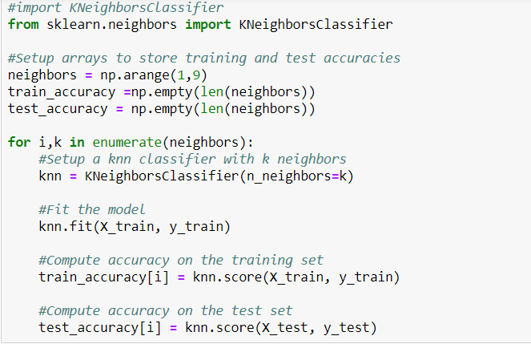
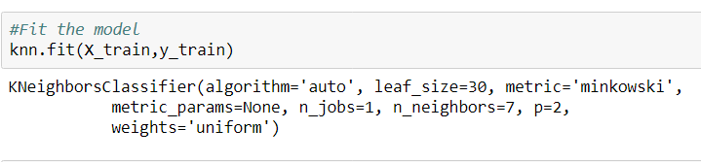

Slide 14
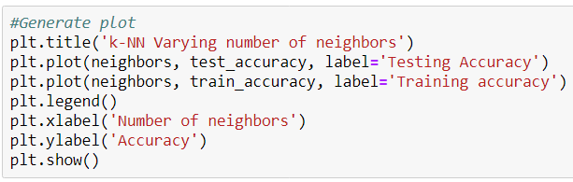
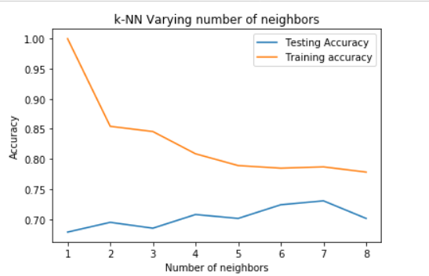
This plot shows the training and test set accuracy on the y-axis against the setting of Number of neighbors on the x-axis. The best performance is somewhere around 7 neighbors.

Slide 15

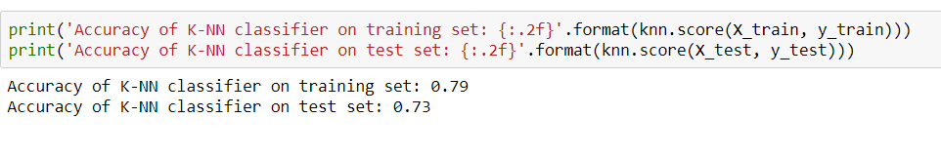
We can observe above that we get maximum testing accuracy for k=7. So we created a KNeighborsClassifier with number of neighbors as 7.

Slide 16
CROSS VALIDATION
Cross-validation is a technique to evaluate predictive models by partitioning the original sample into a training set to train the model, and a test set to evaluate it.
In k-fold cross-validation, the original sample is randomly partitioned into k equal size subsamples. Of the k subsamples, a single subsample is retained as the validation data for testing the model, and the remaining k-1 subsamples are used as training data. The cross-validation process is then repeated k times (the folds), with each of the k subsamples used exactly once as the validation data. The k results from the folds can then be averaged (or otherwise combined) to produce a single estimation. The advantage of this method is that all observations are used for both training and validation, and each observation is used for validation exactly once.

Slide 17
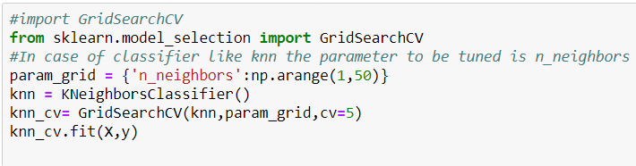
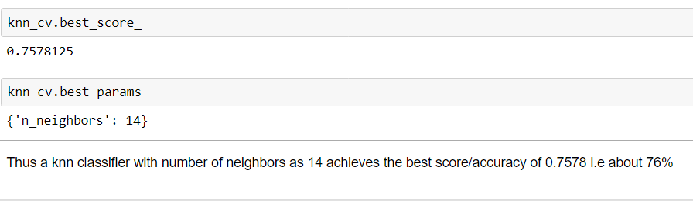

Slide 18
THANK YOU
Regards Avleen Kaur Bakshi

